Slide 1
The Easter STory
Told with cookies!

Slide 2
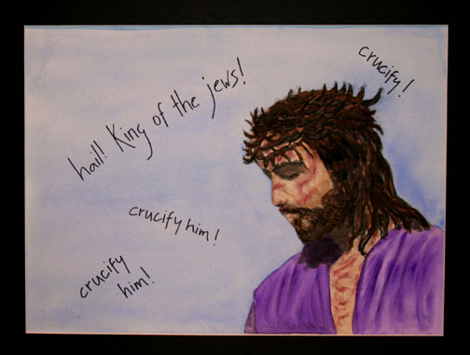
“Then Pilate took Jesus and had him flogged. And the soldiers wove a crown of thorns and put it on his head, and they dressed him in a purple robe. They kept coming up to him, saying, “Hail, King of the Jews!” and striking him on the face.”
John 19:1-3

Slide 3
After this, when Jesus knew that all was now finished, he said (in order to fulfill the scripture), “I am thirsty.” A jar full of sour wine was standing there. So they put a sponge full of the wine on a branch of hyssop and held it to his mouth. When Jesus had received the wine, he said, “It is finished.” Then he bowed his head and have up his spirit.
- John 19:28-30

Slide 4
“The thief comes only to steal and kill and destroy. I came that they may have life, and have it abundantly. “I am the Good Shepherd. The good shepherd lays down his life for the sheep.” ”
- John 10:10-11

Slide 5
“A great number of the people followed him, and among them were women who were beating their chests and wailing for him.”
- Luke: 23:27

Slide 6
“O taste and see that the Lord is good; happy are those who take refuge in him.”
Psalm 34:8
“For God so loved the world that he gave his only Son, so that everyone who believes in him may not perish but have eternal life.”
- John 3:16

Slide 7
“Come now, let us argue it out, says the Lord: though your sins are like scarlet, they shall be like snow; though they are red like crimson, they shall become like wool.”
– Isaiah 1:18
“Now there was a Pharisee named Nicodemus, a leader of the Jews. He came to Jesus by night and said to him, “Rabbi, we know that you are a teacher who has come from God; for no one can do these signs that you do apart from the presence of God.” Jesus answered him, “Very truly, I tell you, no one can see the kingdom of God without being born from above.” “
– John 3:1-3

Slide 8
“When it was evening, there came a rich man from Arimathea, named Joseph, who was also a disciple of Jesus. He went to Pilate and asked for the body of Jesus; then Pilate ordered I to be given to him. So Joseph took the body and wrapped it in a clean linen cloth and laid it in his own new tomb, which he had hewn in the rock. He then rolled a great stone to the door of the tomb and went away.”
- Matthew 27:57-60

Slide 9
“Pilate said to them, “You have a guard of soldiers; go, make it as secure as you can.” So they went with the guard and made the tomb secure by sealing the stone.”
- Matthew 27:65-66

Slide 10
“Very truly, I tell you, you will weep and mourn, but the world will rejoice; you will have pain, but your pain will turn to joy… So you have pain now, but I will see you again, and your hearts will rejoice, and no one will take your joy from you.”
- John 16:20, 22

Slide 11
“After the Sabbath, as the first day of the week was dawning, Mary Magdalene and the other Mary went to see the tomb. And suddenly there was a great earthquake; for an angel of the Lord, descending from heaven, came and rolled back the stone and sat on it. His appearance was like lightning, and his clothing white as snow. For hear of him the guards shook and became like dead men. But the angel said to the women, “Do not be afraid; I know that you are looking for Jesus who was crucified. He is not here; for he has been raised, as he said. Come, see the place where he lay. Then go quickly and tell his disciples, ‘He has been raised from the dead, and indeed he is going ahead of you to Galilee; there you will see him.’ This is my message for you.” So they left the tomb quickly with hear and great joy, and ran to tell his disciples. Suddenly Jesus met them and said, “Greetings!” And they came to him, took hold of his feet, and worshiped him.”
- Matthew 28:1-9

Slide 12
The Easter Story

